Slide 1
Concurrency Control

Slide 2
Lock-Based Protocols
A lock is a mechanism to control concurrent access to a data item
Data items can be locked in two modes :
1. exclusive (X) mode. Data item can be both read as well as written. X-lock is requested using lock-X instruction.
2. shared (S) mode. Data item can only be read. S-lock is requested using lock-S instruction.
Lock requests are made to concurrency-control manager. Transaction can proceed only after request is granted.

Slide 3
Lock-Based Protocols (Cont.)
Example of a transaction performing locking:
T₂: lock-S(A);
read (A);
unlock(A);
lock-S(B);
read (B);
unlock(B);
display(A+B)
Locking as above is not sufficient to guarantee serializability — if A and B get updated in-between the read of A and B, the displayed sum would be wrong.
A locking protocol is a set of rules followed by all transactions while requesting and releasing locks. Locking protocols restrict the set of possible schedules.

Slide 4
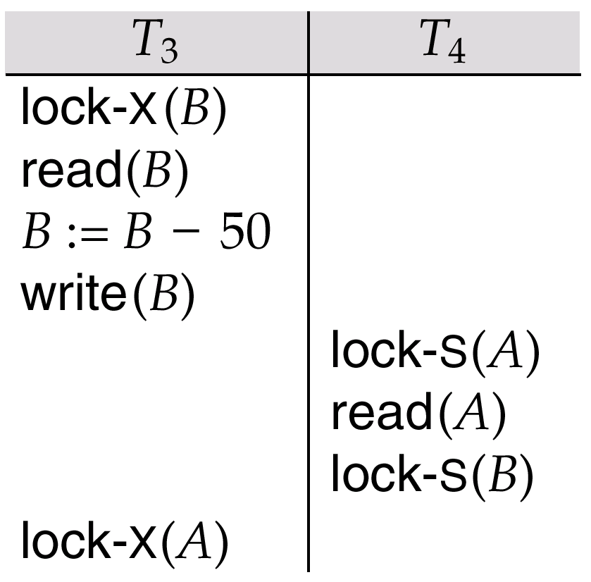
Pitfalls of Lock-Based Protocols
Consider the partial schedule
Neither T₃ nor T₄ can make progress — executing lock-S(B) causes T₄ to wait for T₃ to release its lock on B, while executing lock-X(A) causes T₃ to wait for T₄ to release its lock on A.
Such a situation is called a deadlock.
To handle a deadlock one of T₃ or T₄ must be rolled back and its locks released.

Slide 5
Pitfalls of Lock-Based Protocols (Cont.)
The potential for deadlock exists in most locking protocols. Deadlocks are a necessary evil.
Starvation is also possible if concurrency control manager is badly designed. For example:
A transaction may be waiting for an X-lock on an item, while a sequence of other transactions request and are granted an S-lock on the same item.
The same transaction is repeatedly rolled back due to deadlocks.
Concurrency control manager can be designed to prevent starvation.

Slide 6
The Two-Phase Locking Protocol
This is a protocol which ensures conflict-serializable schedules.
Phase 1: Growing Phase
transaction may obtain locks
transaction may not release locks
Phase 2: Shrinking Phase
transaction may release locks
transaction may not obtain locks
The protocol assures serializability. It can be proved that the transactions can be serialized in the order of their lock points (i.e. the point where a transaction acquired its final lock).

Slide 7
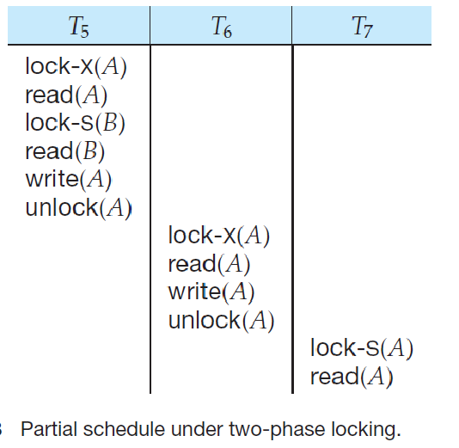

Slide 8
The Two-Phase Locking Protocol (Cont.)
Two-phase locking does not ensure freedom from deadlocks
Cascading roll-back is possible under two-phase locking. To avoid this, follow a modified protocol called strict two-phase locking. Here a transaction must hold all its exclusive locks till it commits/aborts.
Rigorous two-phase locking is even stricter: here all locks are held till commit/abort. In this protocol transactions can be serialized in the order in which they commit.

Slide 9
Lock Conversions
Two-phase locking with lock conversions:
– First Phase:
can acquire a lock-S on item
can acquire a lock-X on item
can convert a lock-S to a lock-X (upgrade)
– Second Phase:
can release a lock-S
can release a lock-X
can convert a lock-X to a lock-S (downgrade)
This protocol assures serializability. But still relies on the programmer to insert the various locking instructions.

